Slide 1
Project work: DBHost
Author: Tibor Péter Szabó
GitHub: DBHost
Matriculation Number: 92124338
Subject: Project: Java and Web Development (DLBCSPJWD01)
Tutor: Sandra Rebholz

Slide 2
Purpose of the application:
This application was designed to aid company personnel to manage other employees and assets.
The application provides secure login, with different access levels to allow or disallow the usage of the different commands of the program.
The application mainly focuses on storing and displaying data about employees, like their location, their availability.
The application is highly extendable due to the fact, that the commands that can be executed are stored in a SQL table as well for easy scalability.

Slide 3
Architecture
Front-end
Displayed website
Java web socket interface
OS File System
SQLite3
HTML files
User details
Contents of the database
Employees
Machines
Workgroups
Request handling threads
Request form admin
Request from Skylar
Provides UI for the user and sends requests
Back-end
Accepts connections
Stores and provides content of the database
Forwards Website files
Handles user requests

Slide 4
Used technologies
Back-end | Communication | Front-end
Java | HTTP | HTML
SQL | XMLRequest | JavaScript
 |  | CSS

Slide 5
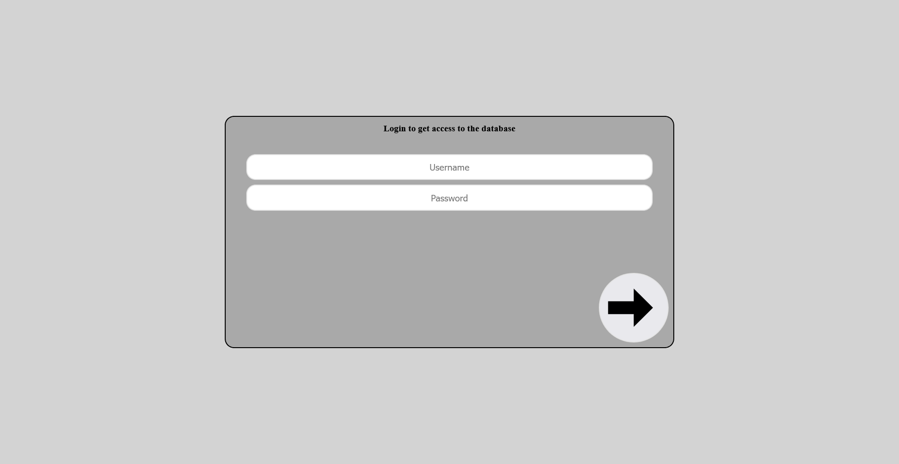
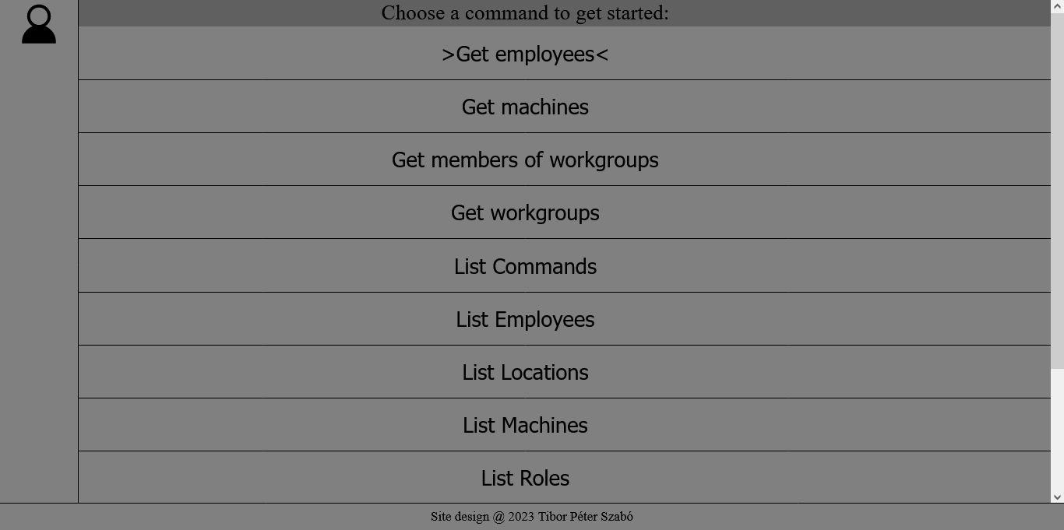
Site display on Desktop
Login Page
Username and Password input
Login button
Profile menu button
Starting Page
List of commands

Slide 6
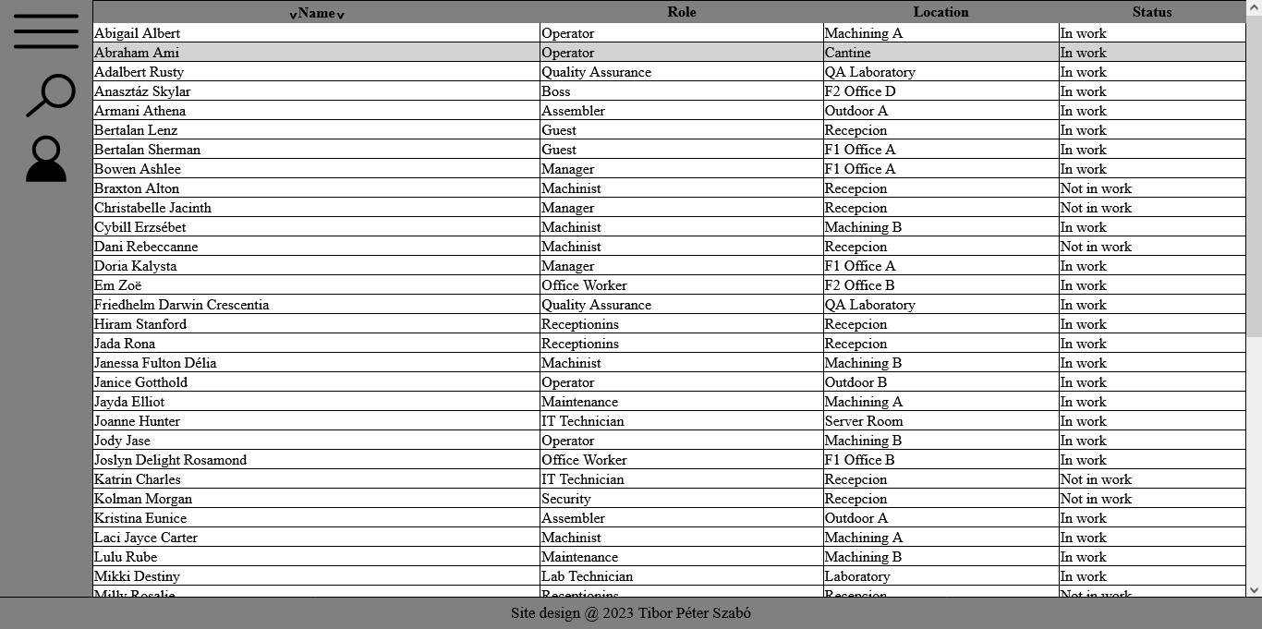
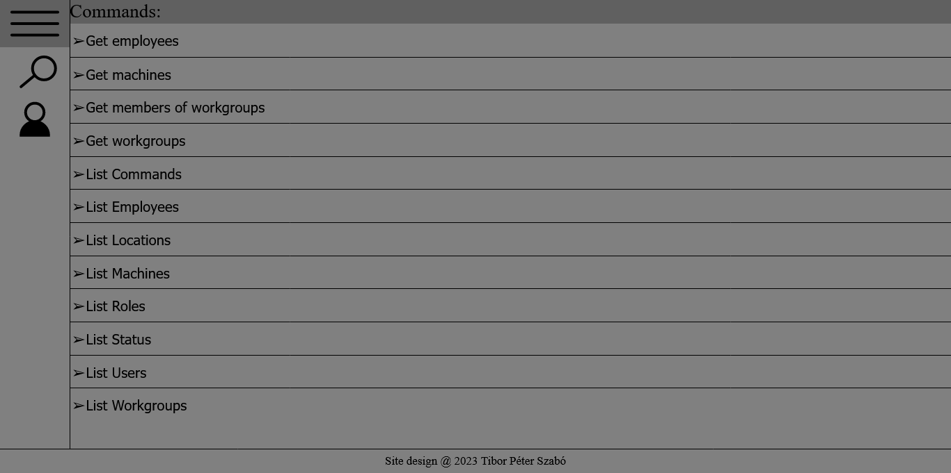
Site display on Desktop
Commands menu button
Table display Page
Filter menu button
Profile menu button
Displayed data
Commands menu button
Commands Menu
Filter menu button
Profile menu button
List of commands

Slide 7
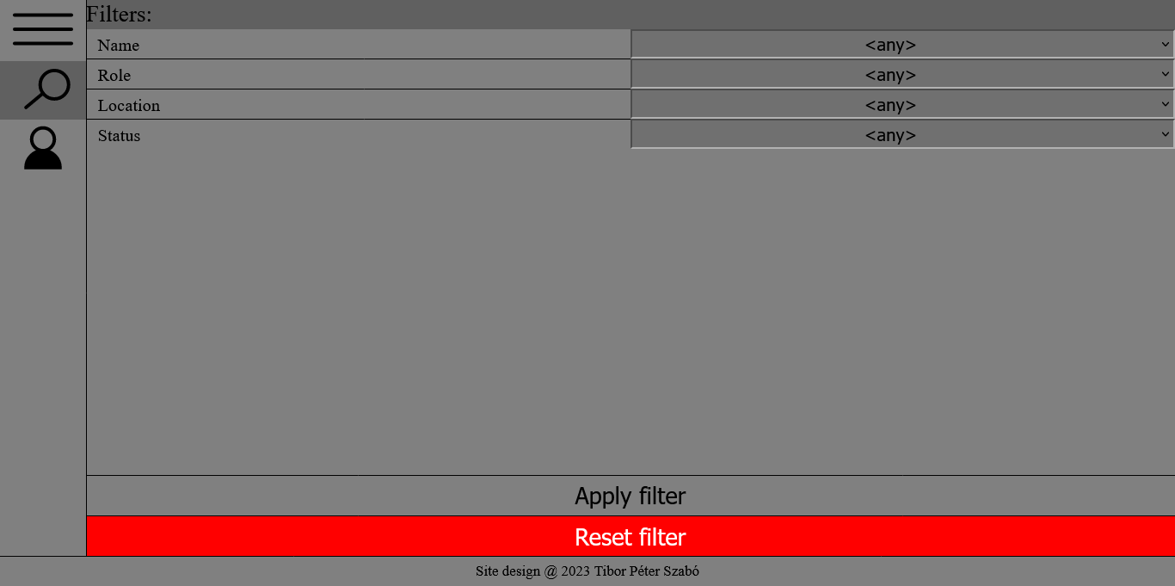
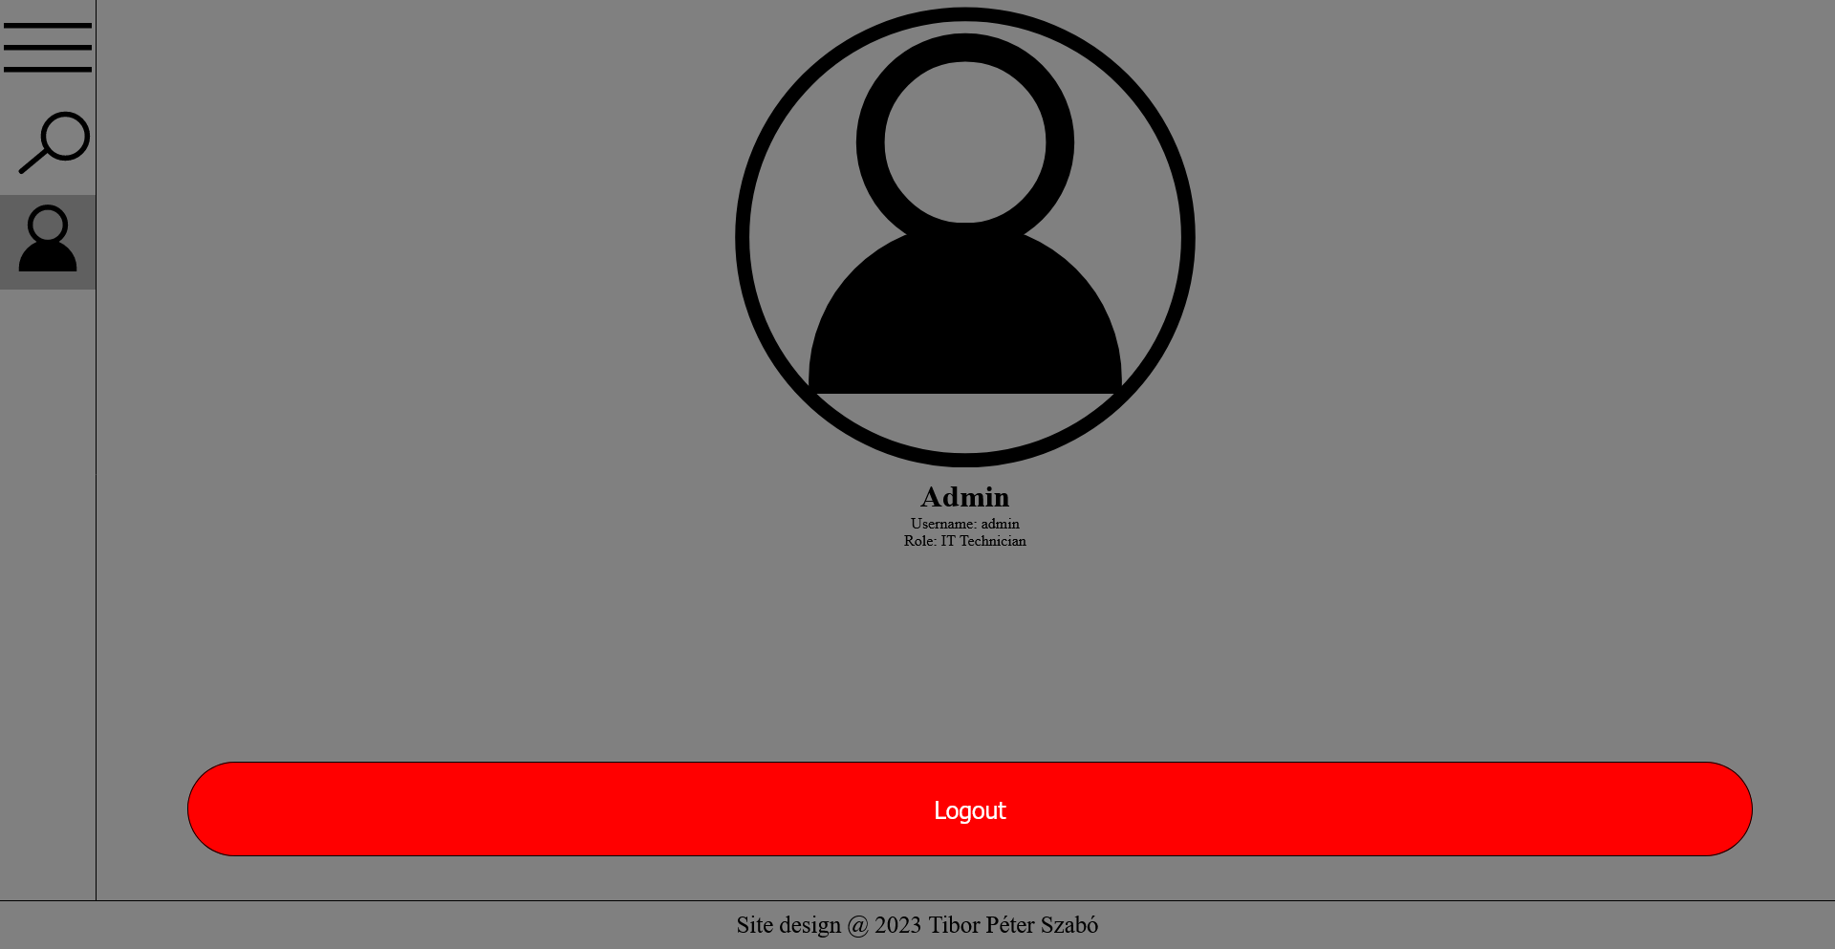
Site display on Desktop
Commands menu button
Login Page
Filter menu button
Profile menu button
List of filters
Apply selected filters
Reset filters
Commands menu button
Starting Page
Filter menu button
Profile menu button
Information about the user
Log out

Slide 8
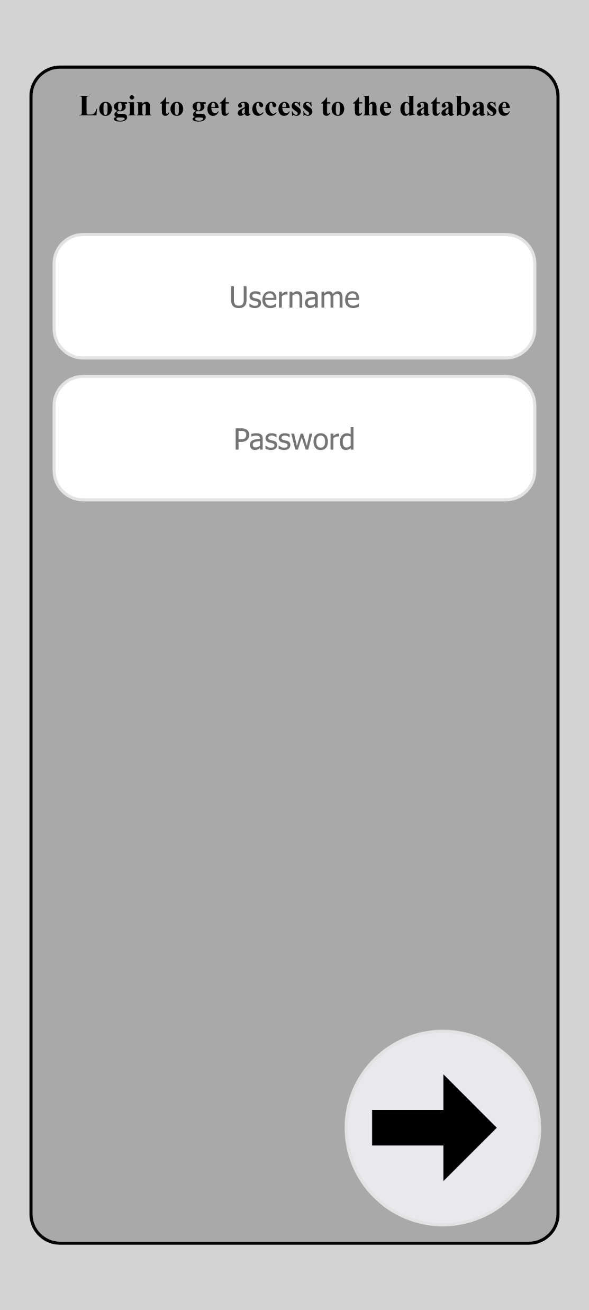
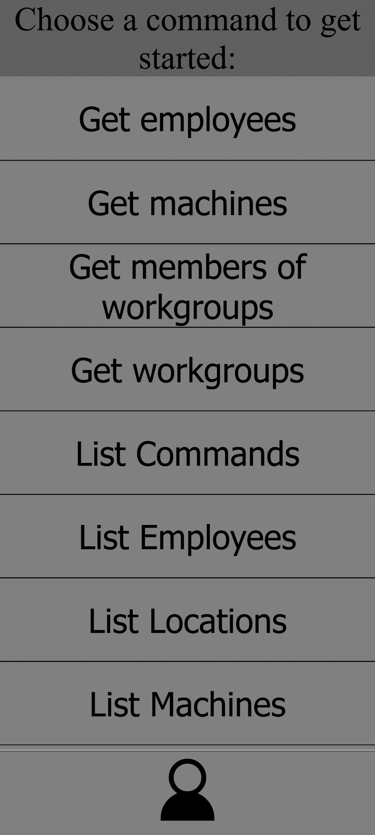
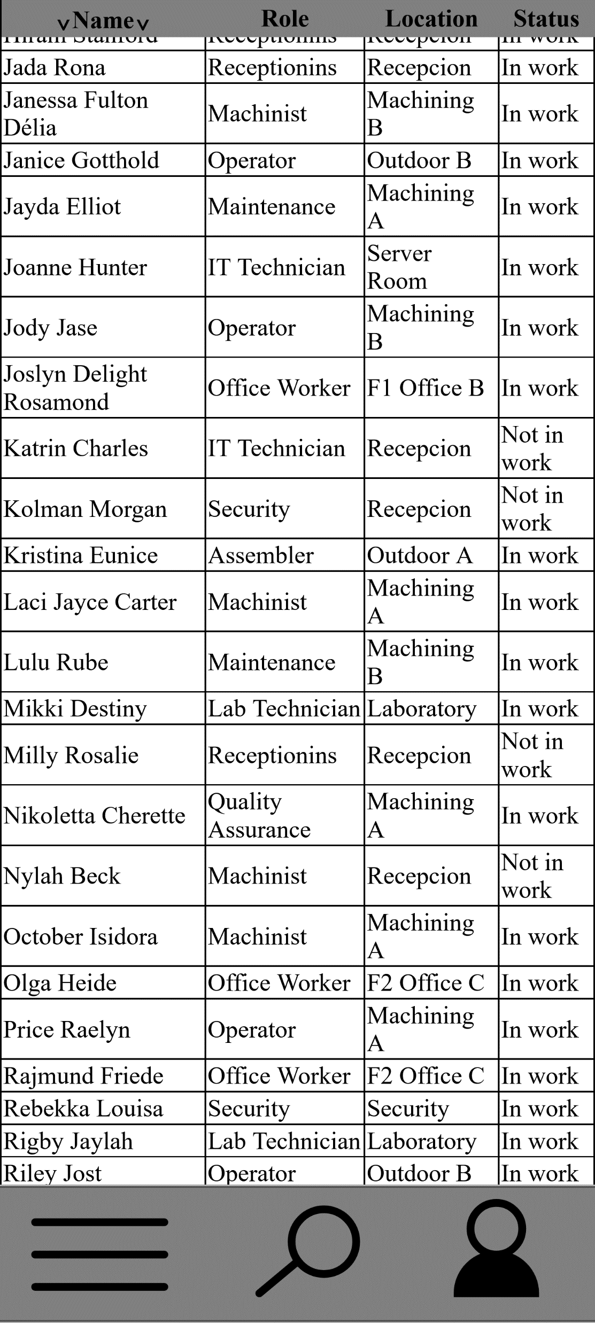
Site display on Mobile
Failed to load: Image of Login Page
Failed to load: Image of starting page
Failed to load: Image of data display
Login Page
Starting Page
Data Display Page

Slide 9
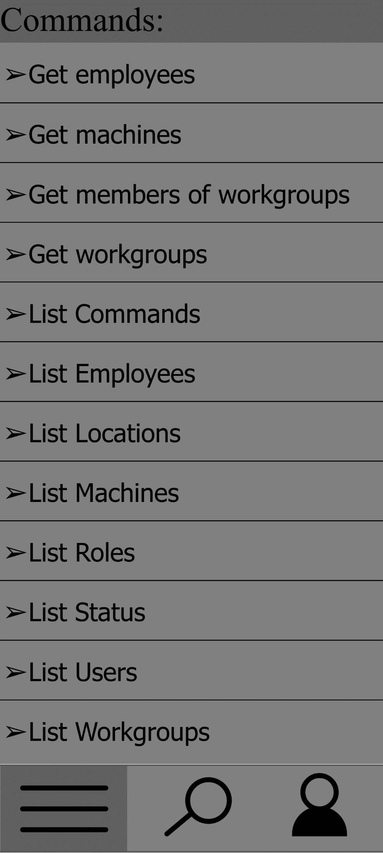
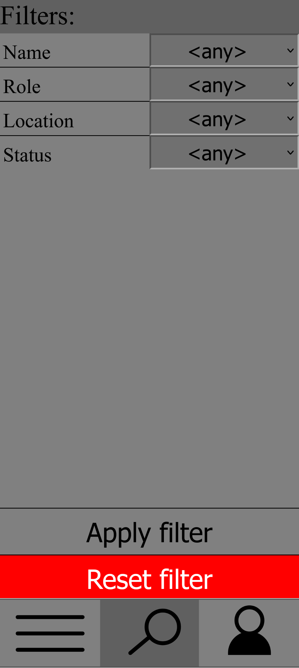

Site display on Mobile
Failed to load: Image of commands menu
Failed to load: Image of filter menu
Failed to load: Image of profile menu
Commands Menu
Filter Menu
Profile Menu

Slide 10
Changes
Concept | End result | Reason
Custom SQL queries | Left unimplemented | Risk of SQL Injection vulnerability
Bootstrap.css library | Pure CSS code | Much higher style customizability
HTTP Auth protocol | HTTP cookie | HTTP Auth protocol was not flexible enough to use it as a possible solution for login UI.

Slide 11
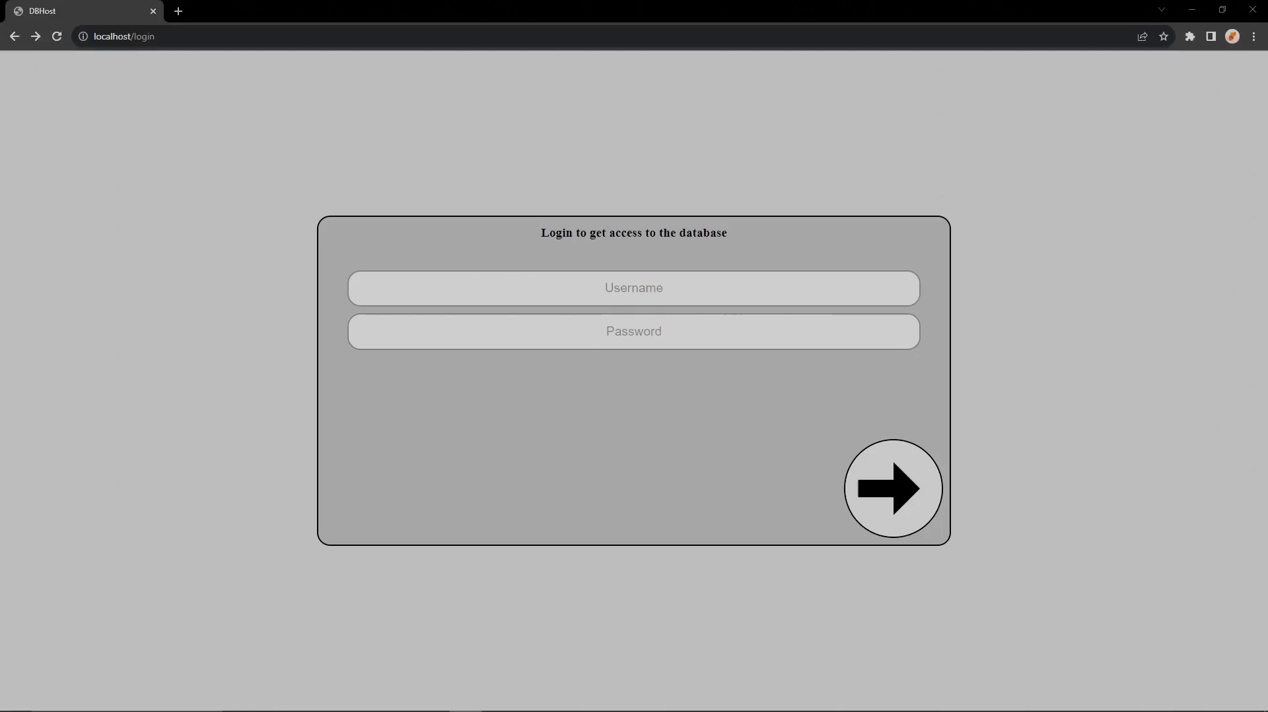
Video demonstration of the website

